Slide 1

ATAC-seq / scATAC-seq
Caleb Lareau
Immunology 206
02 March 2023

Slide 2
Overview of content
Part 0: A motivating example / regulatory elements used in the clinic
Part I: Chromatin accessibility + early technologies
Part II: Bulk ATAC-seq, applications, and improvements
Part III: Single-cell ATAC technologies
Part IV: Thinking about scATAC-seq data and analyses

Slide 3

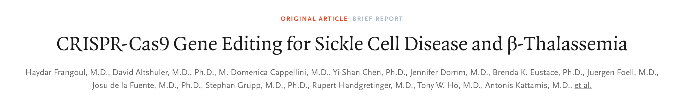
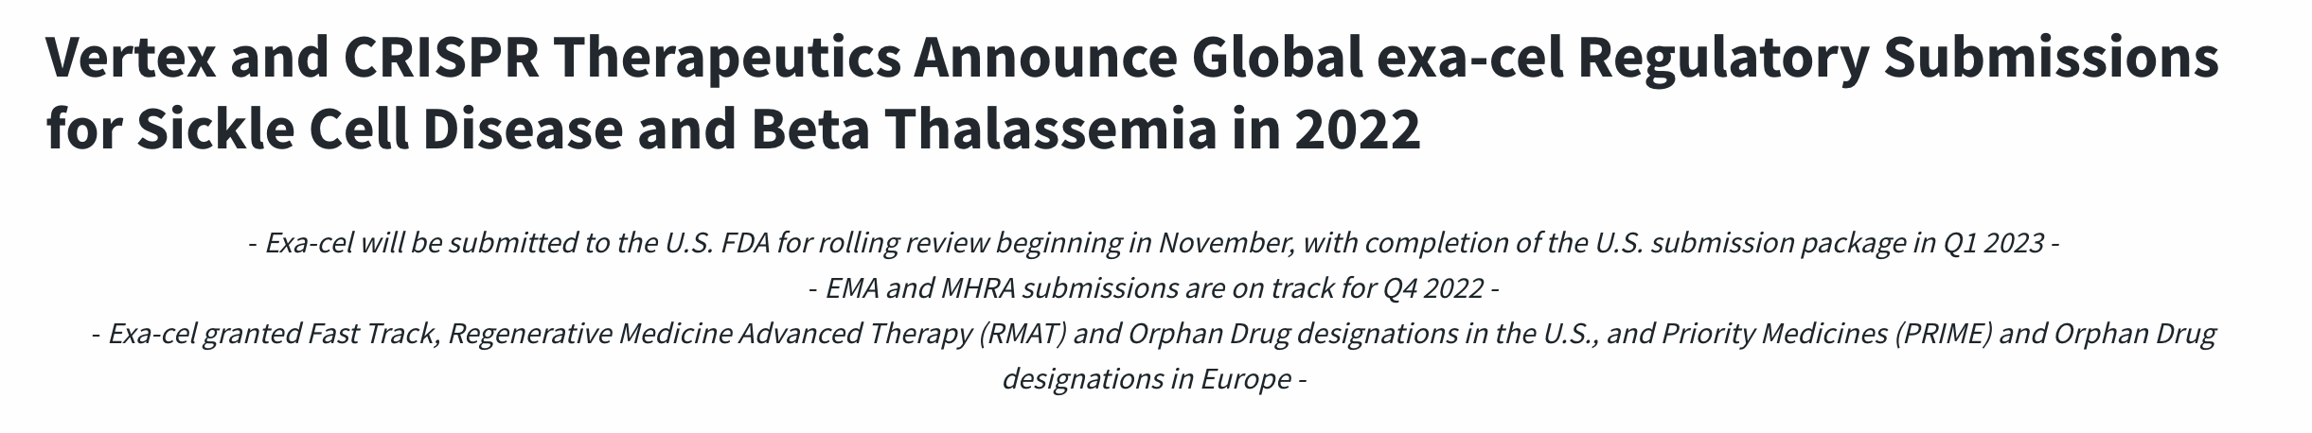
Exa-cell / CTX001

Slide 4
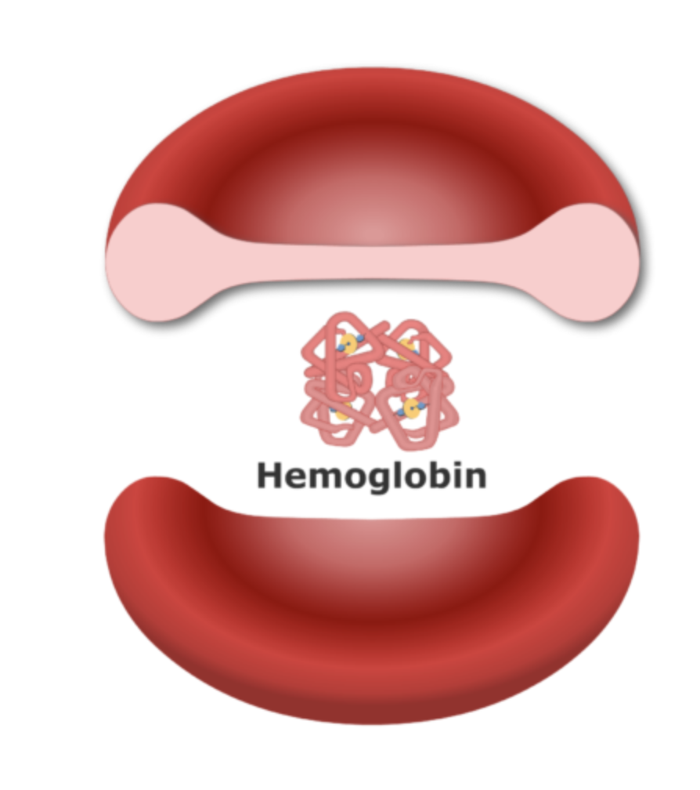
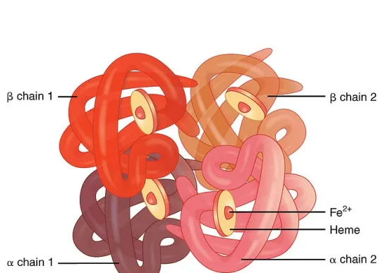
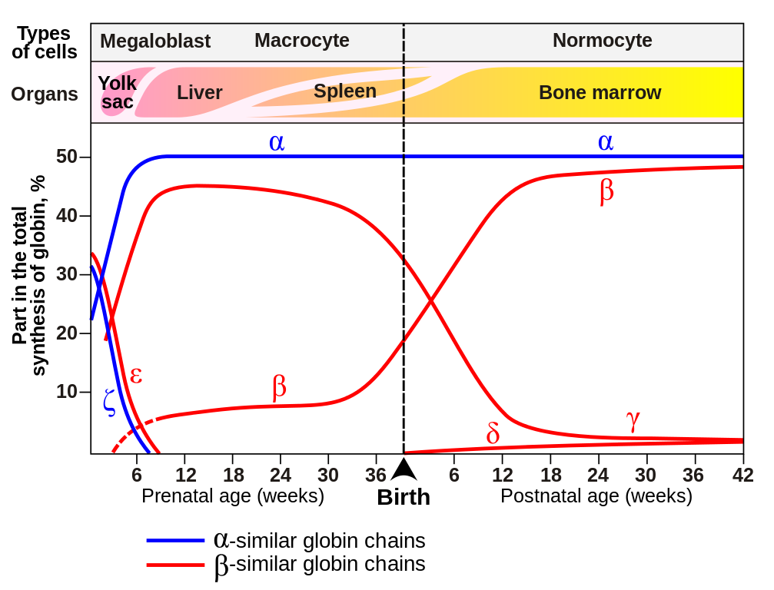
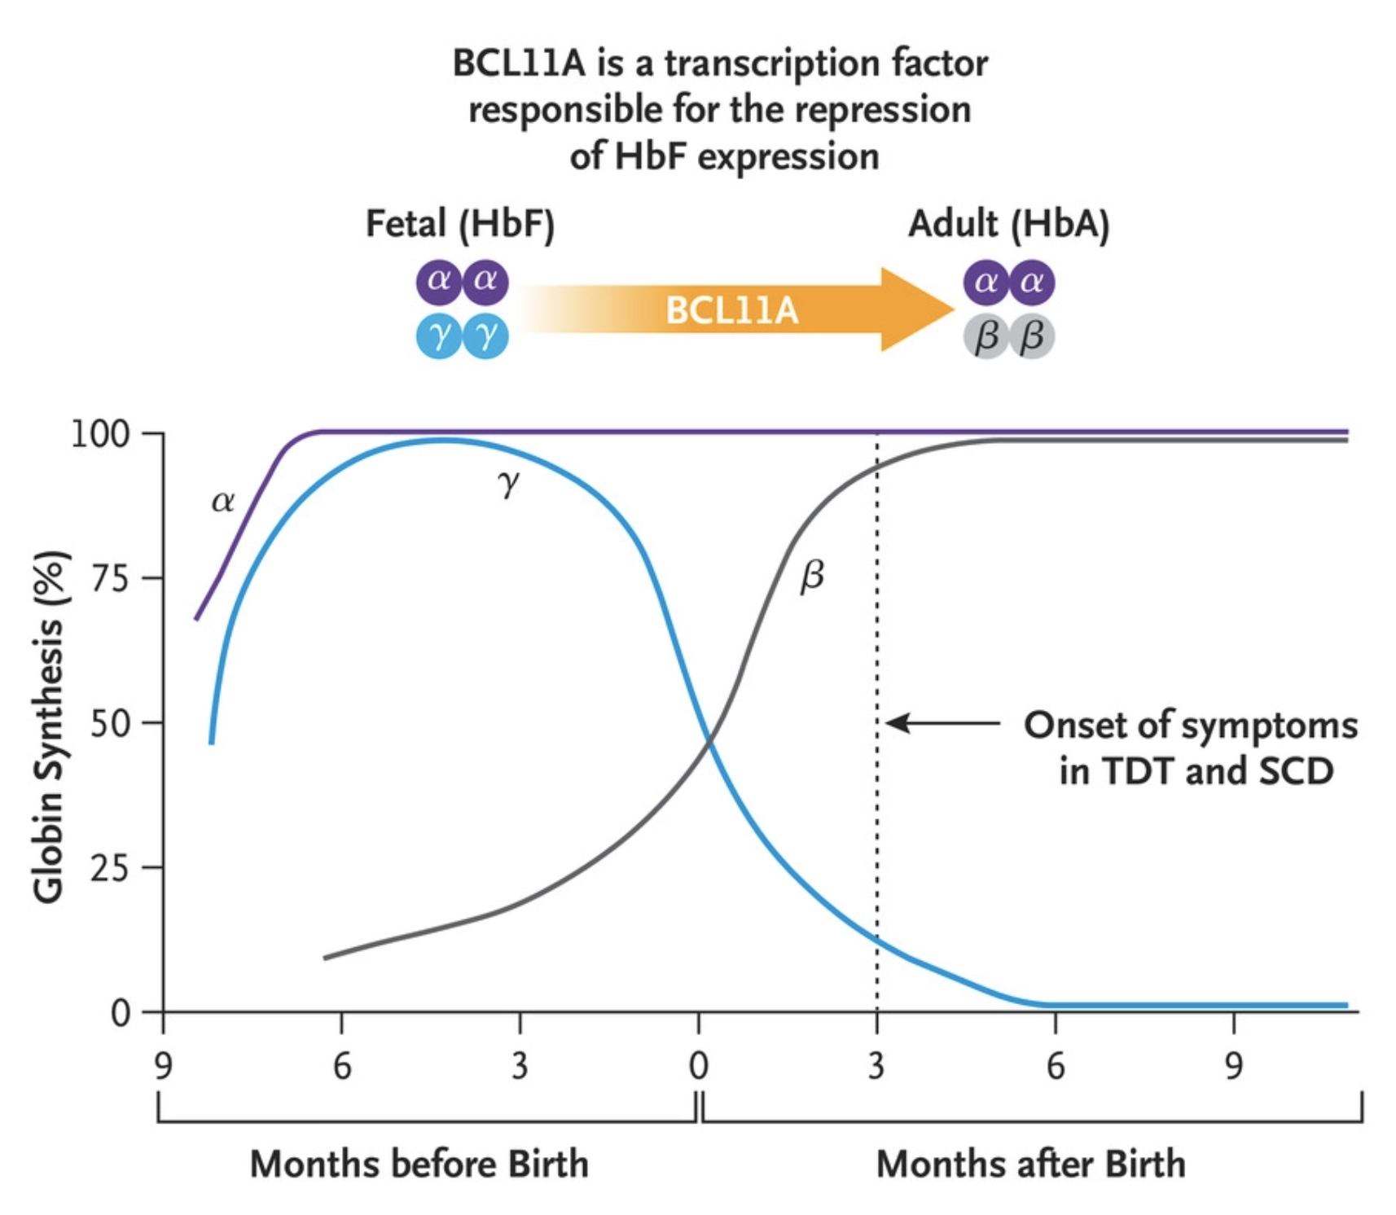
Hemoglobin switching

Slide 5
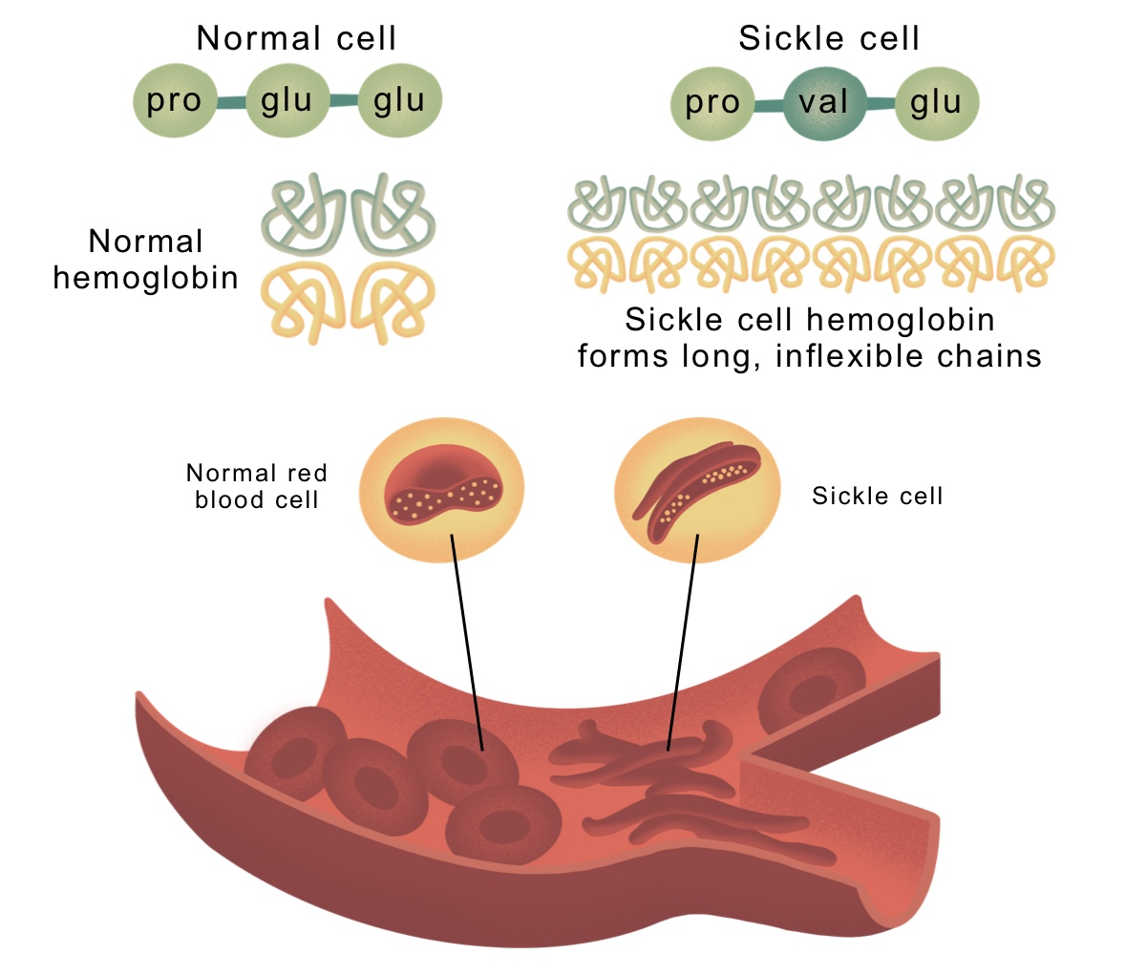
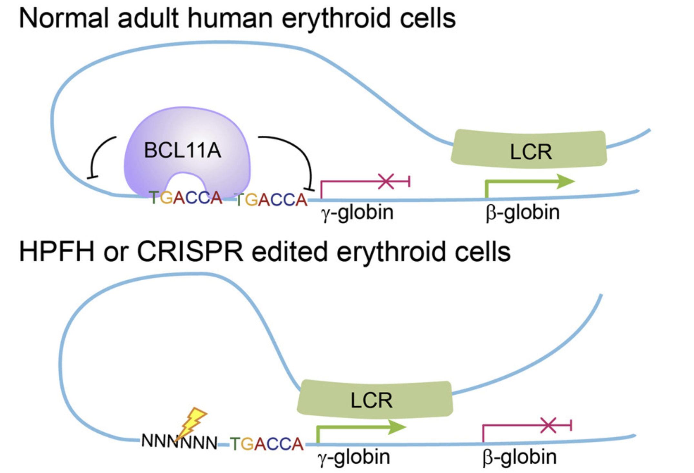
Sickle cell anemia is caused by a point mutation in the B-globin gene
Beta globin:

Slide 6
Strategy
Can we edit red blood cells? Why or why not?
If we edit hematopoietic stem and progenitor cells, how does manipulating BCL11A affect the body?
It turns out the BCL11A is critical in B cell formation, so you don’t want to do a global knockout…
What are the genetic tools that allow us to perform a cell type-specific KO of BCL11A?

Slide 7
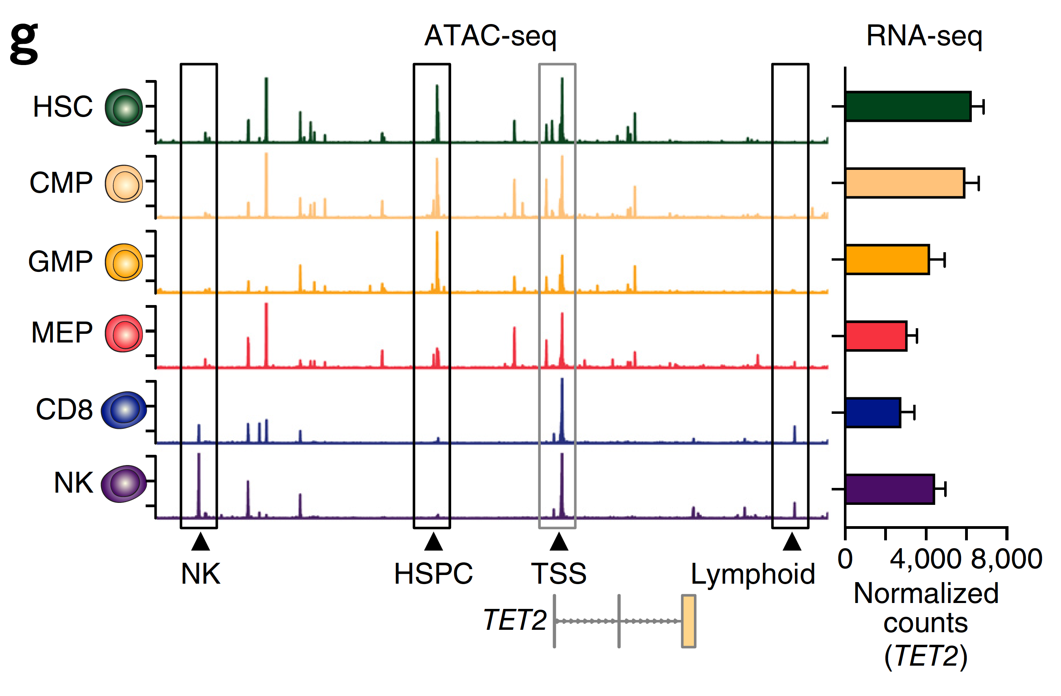
Regulatory DNA provides the solution
Corces et al. Nature Genetics (2016)

Slide 8
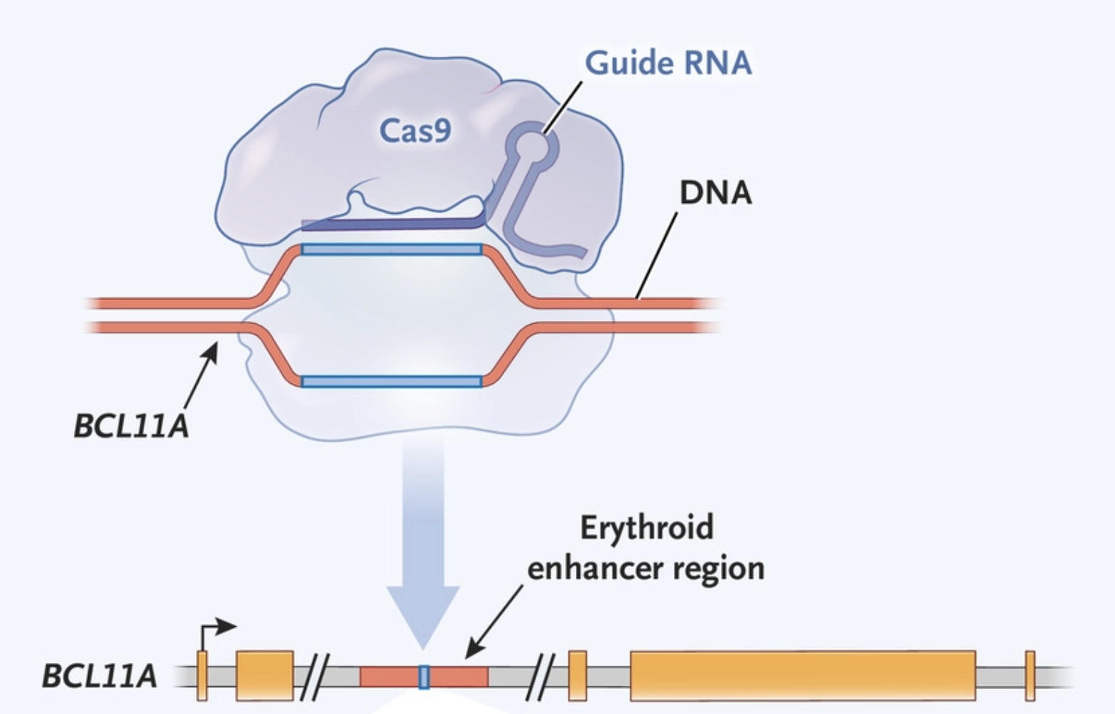
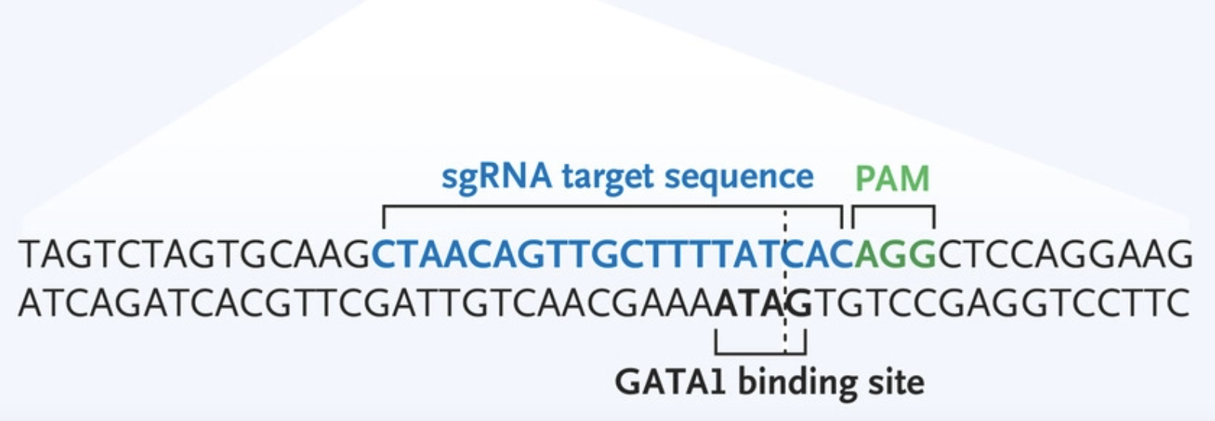
CTX001 / exa-cell targets the erythroid-specific enhancer of BCL11A
By editing the erythroid ‘enhancer’
of BCL11A, we can specify expression
alteration in the erythroid but not the
B lymphocyte lineage

Slide 9
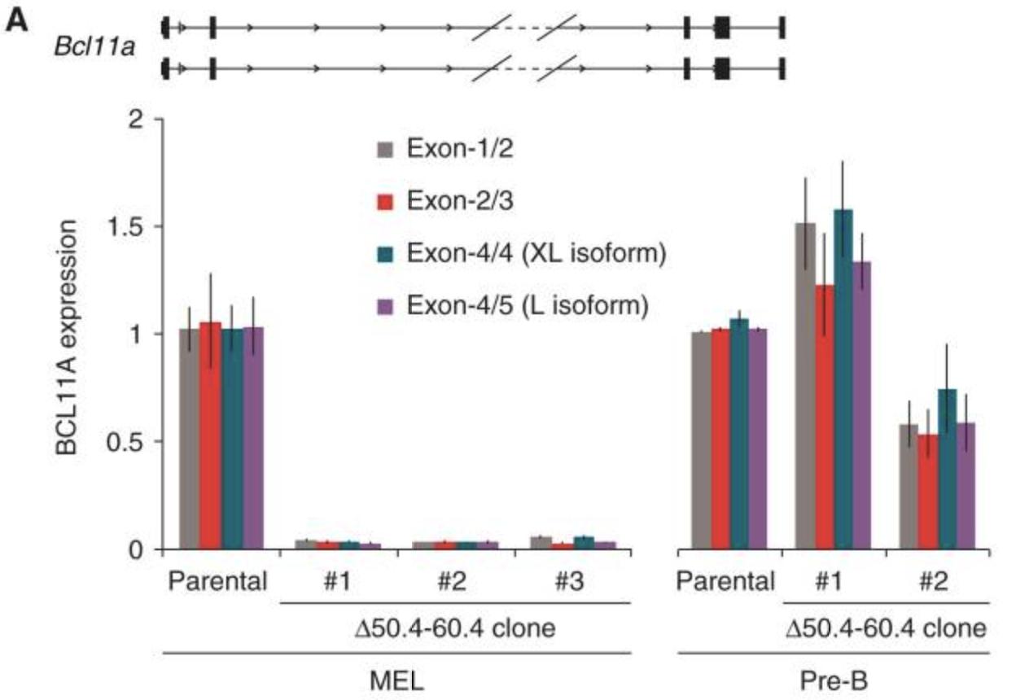
So does it work?
No change in expression in B cells; KD in erythroid cells
Canver et al Nature 2015

Slide 10
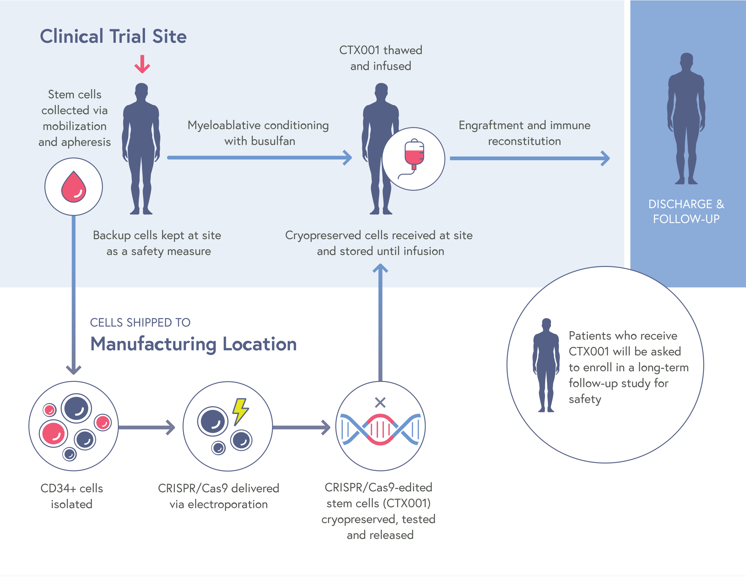
Full overview

Slide 11
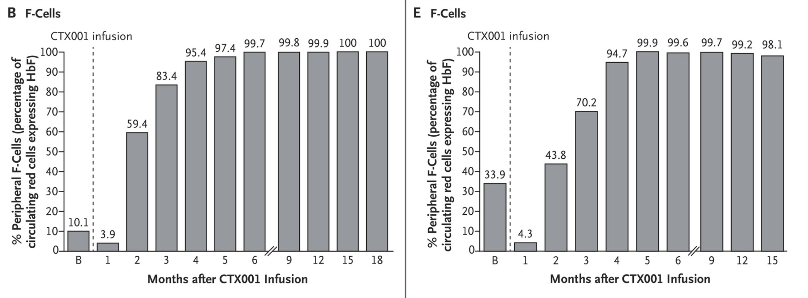
CTX001 infusion result– it works!

Slide 12
Part 0 summary
A promising CRISPR-mediated gene therapy utilizes cell type-specific regulatory elements
One such therapy actively undergoing clinical trials alters regulatory element to confer specific KO of BCL11A
This enables the emergence of fetal hemoglobin, which can compensate for deficiencies in beta-globin in Sickle Anemia and Beta Thalassemia
Expected FDA approval coming this year
What we’ll spend the rest of the time talking about today: how to easily find regulatory elements in any given cell type

Slide 13
Part I: Chromatin accessibility + early technologies

Slide 14
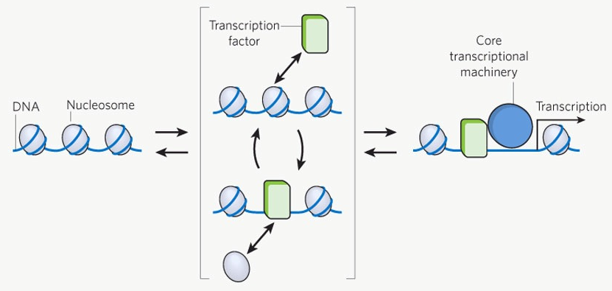
Chromatin accessibility mediates gene regulation
OFF
ON
Kaplan et al. Nature (2012)

Slide 15
How do we measure accessible chromatin?

Slide 16
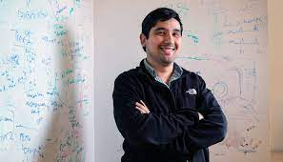
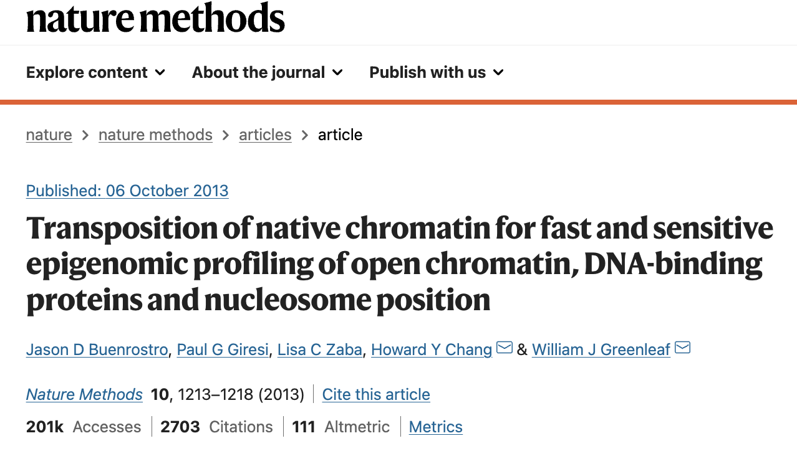
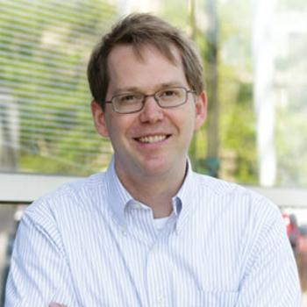
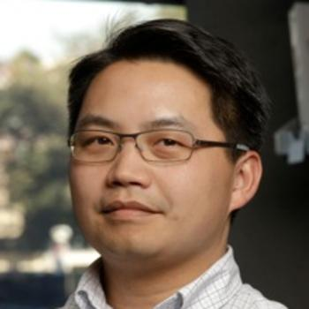
ATAC-seq debuted in 2013 from Stanford Labs
Jason Buenrostro
Will Greenleaf
Howard Chang

Slide 17
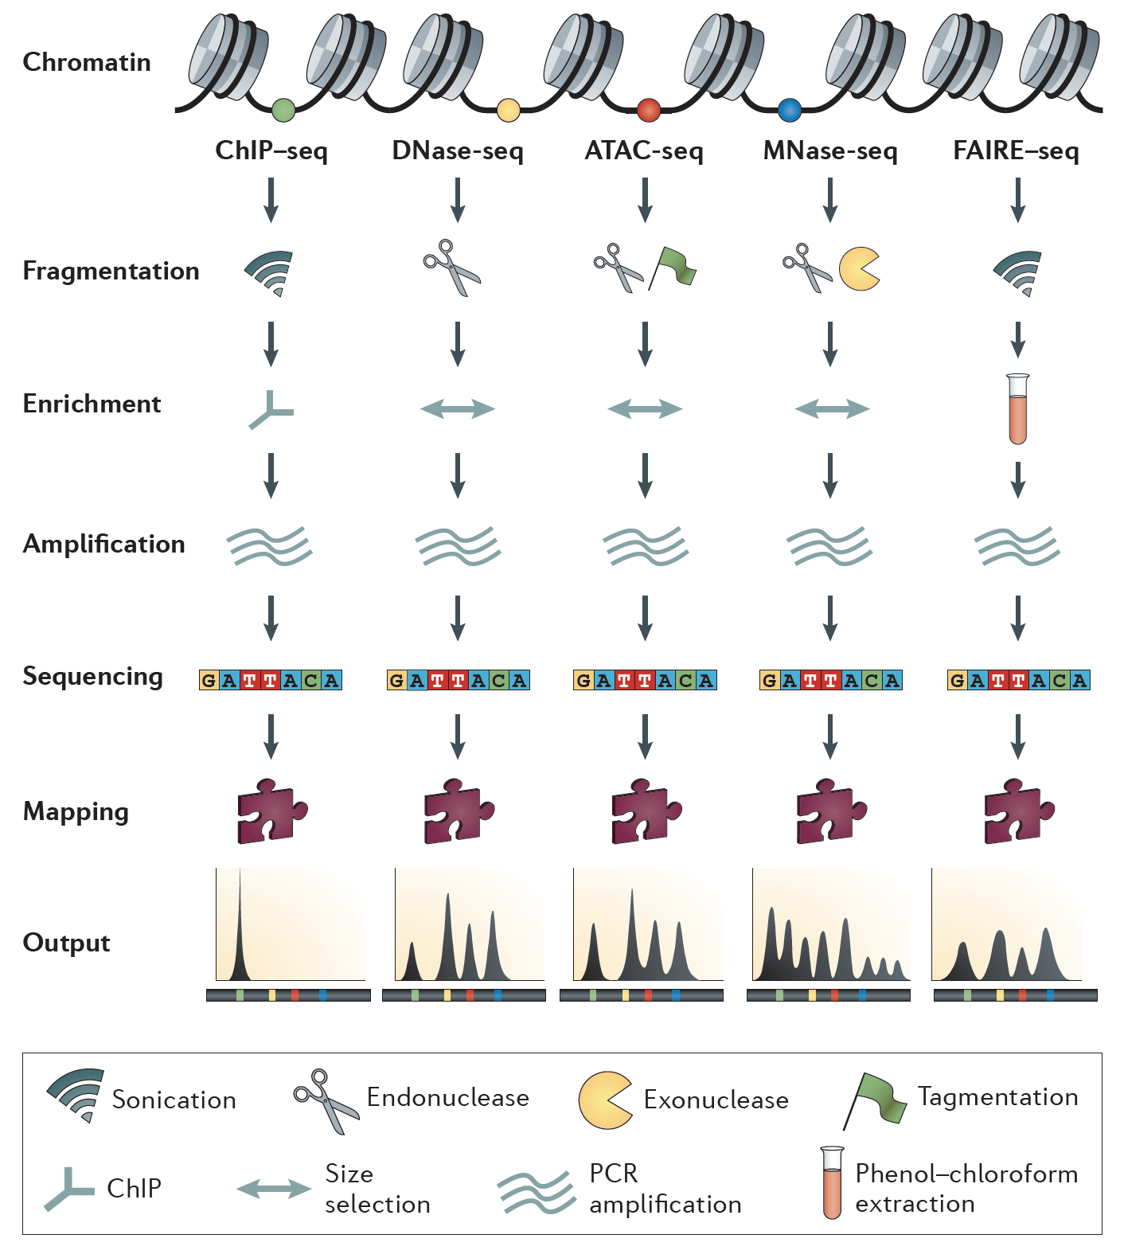
Meyer and Liu. NRG (2014)

Slide 18
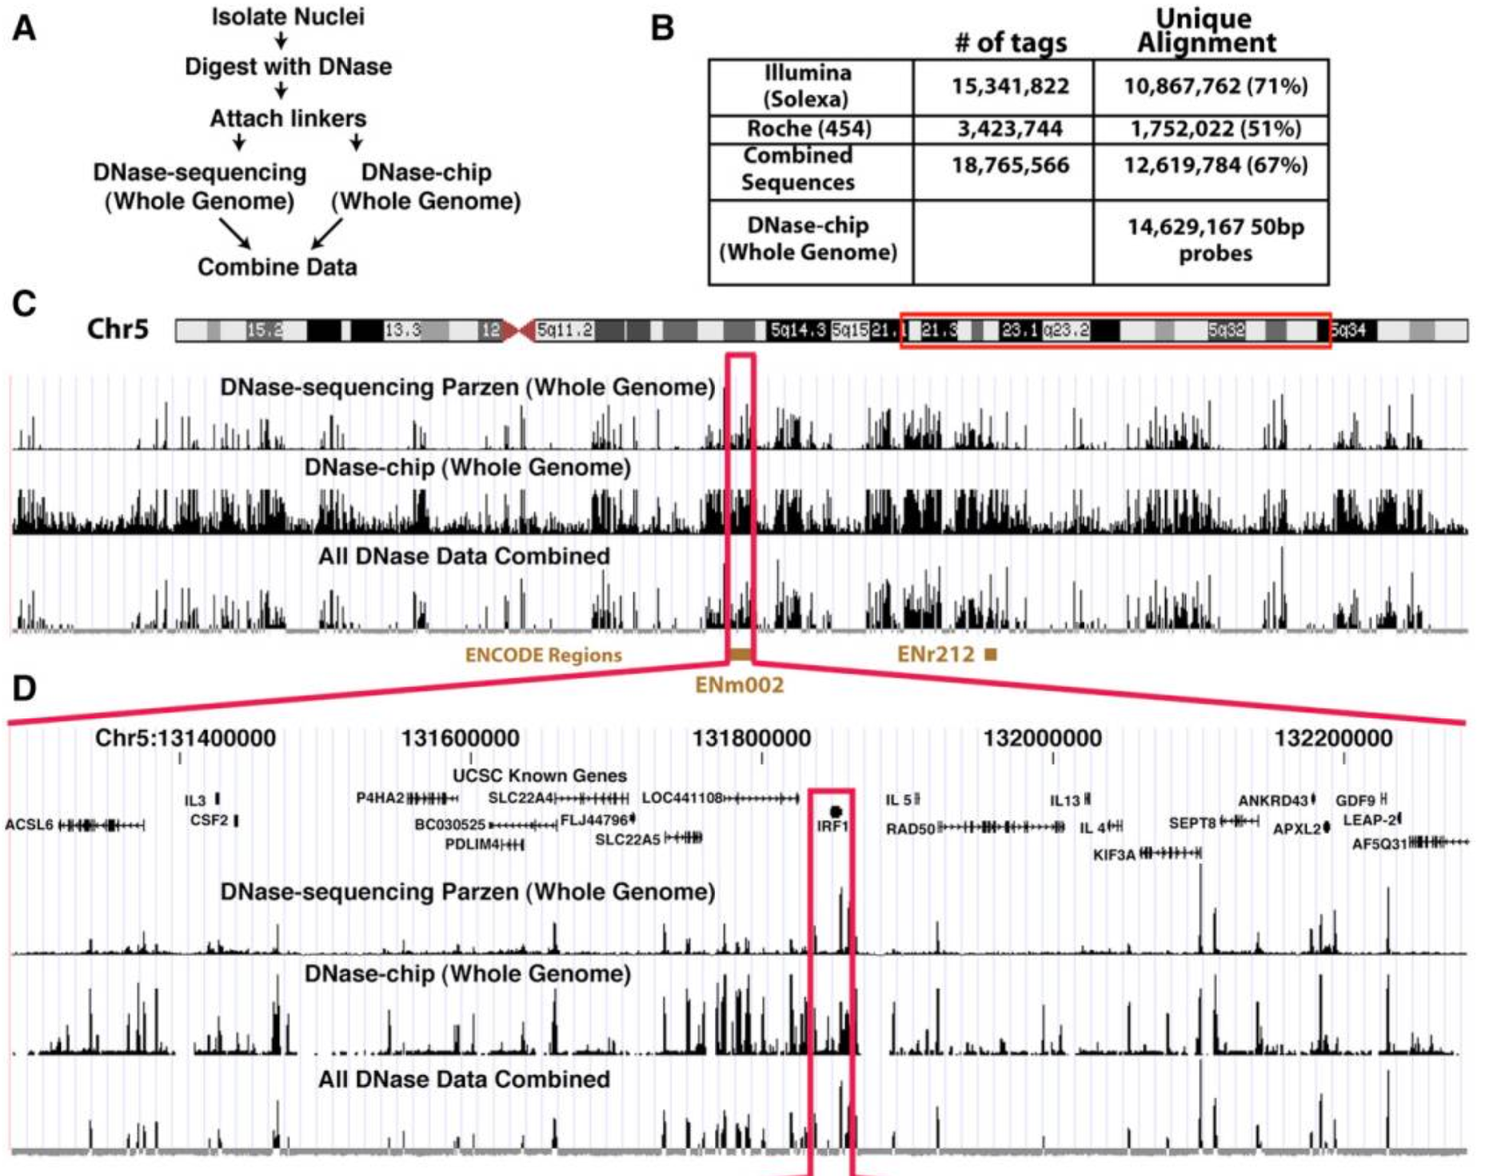
Finding accessible chromatin via DNase-seq
Boyle…Crawford et al. Cell (2008)

Slide 19
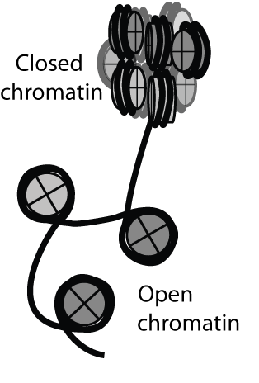

DNase-seq is a relatively inefficient library protocol
DNaseI treatment
Prepare library from fragmented ends and sequence
*44 total steps, steps condensed/removed for graphic, generally requires ~100M cells
Song and Crawford, CSH protocols (2010)

Slide 20
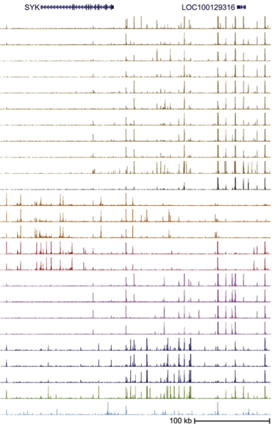




Averaging over cellular heterogeneity
Prepare
libraries
Stergachis et al. Cell (2013)

Slide 21
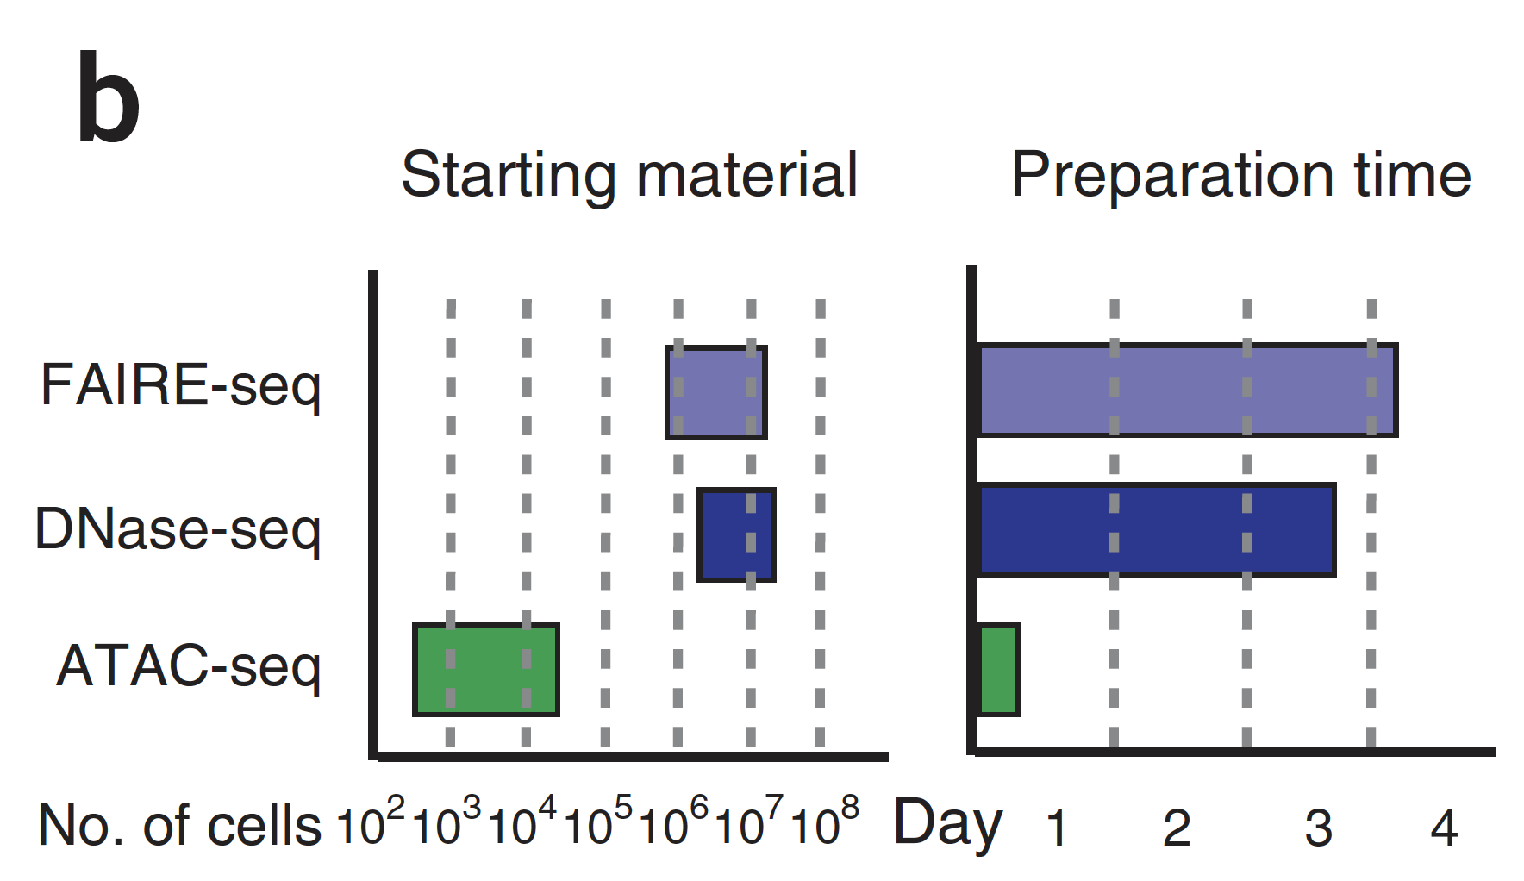
ATAC-seq– an improved epigenomic protocol
Buenrostro et al. Nature Methods (2013)

Slide 22
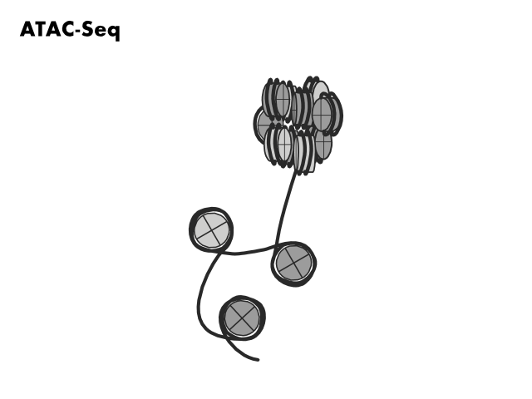

Slide 23
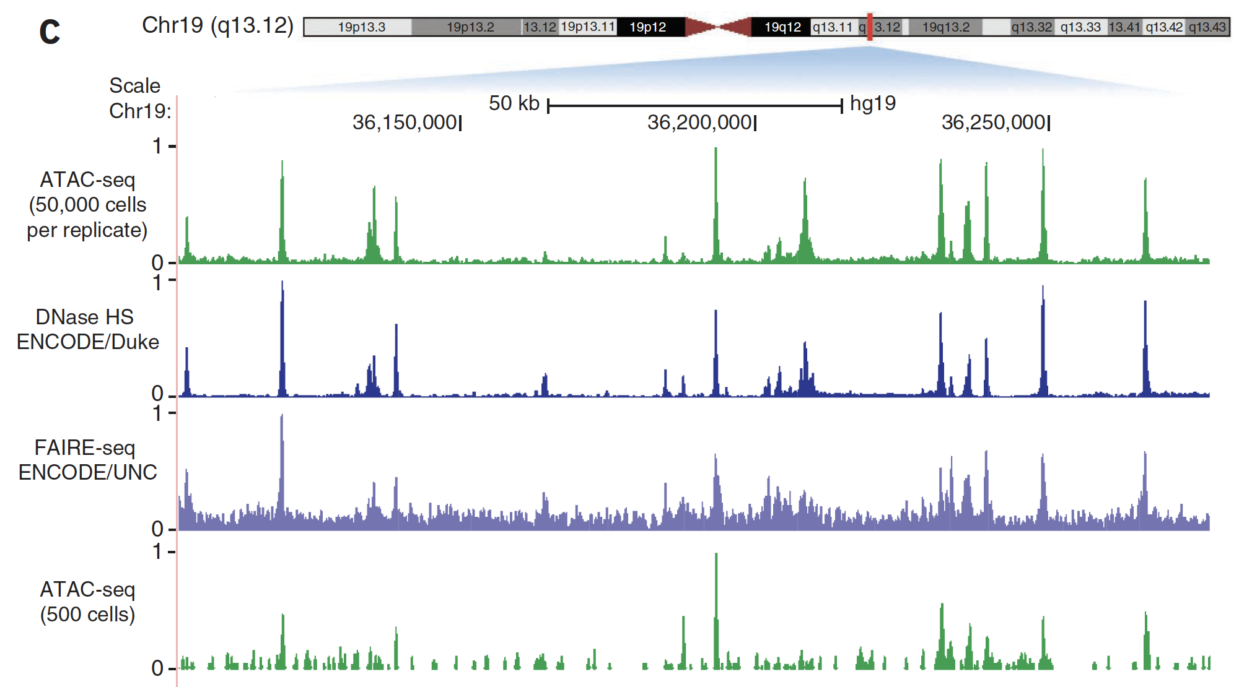
Accessible chromatin landscapes with ATAC-seq
Buenrostro et al. Nature Methods (2013)

Slide 24
Part I Summary
Accessible chromatin is a key mediator of gene expression
Pre-2013 technologies (FAIRE, DNase, and MNase-seq) enabled profiling of accessible chromatin regions that are essential for gene regulation
ATAC-seq (2013) provided a far more efficient protocol for mapping accessible chromatin in fewer cells and in less time
The efficiency gains in ATAC-seq are due in part to tagmentation (adding sequencing adapters) and endonuclease (cutting at accessible chromatin) in one step

Slide 25
Part II: Bulk ATAC-seq

Slide 26
What can bulk ATAC-seq do for you?
Accessible chromatin landscapes
Nucleosome occupancy maps
Transcription factor footprints
Mitochondrial DNA reads

Slide 27
1. Accessible chromatin landscapes
Corces et al. Nature Genetics (2016)

Slide 28
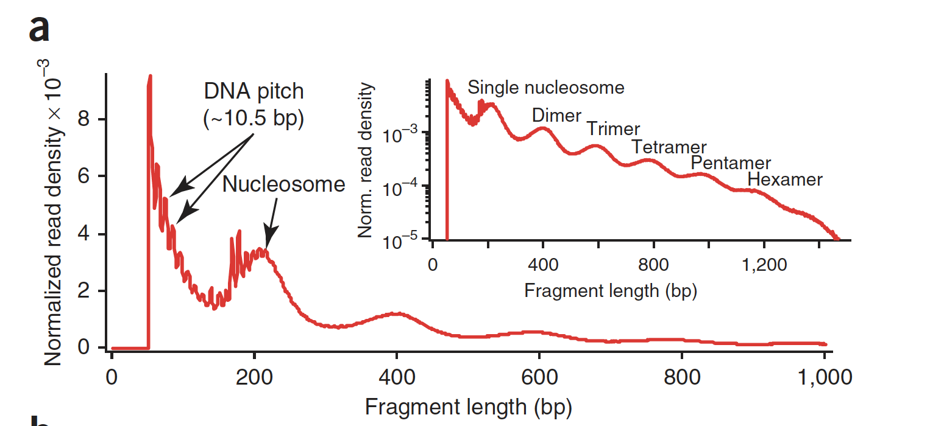
ATAC-seq fragment products
Buenrostro et al. Nature Methods (2013)

Slide 29
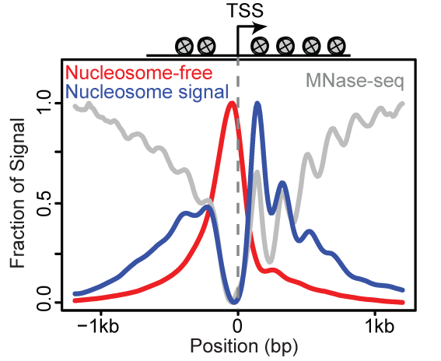
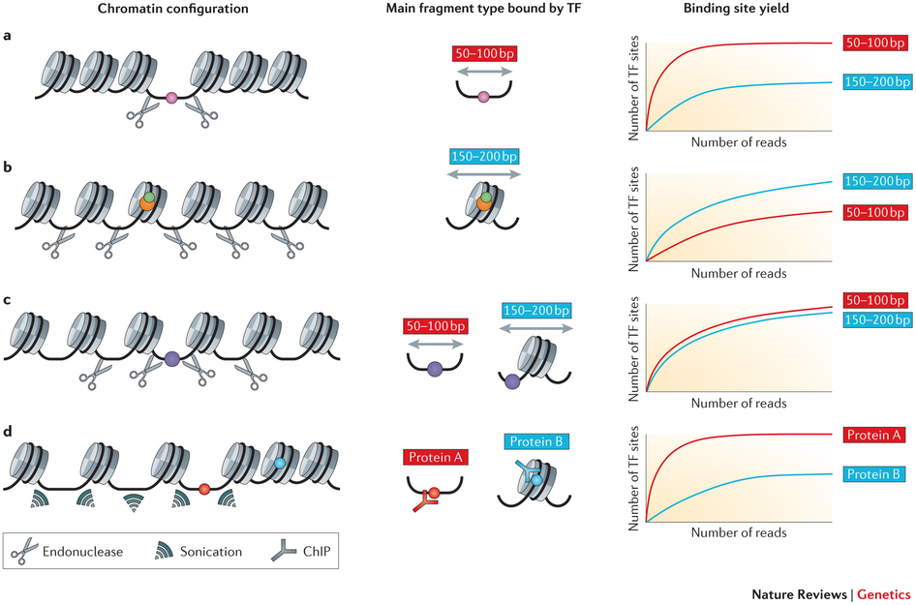
Types of fragments – ATAC-seq
Buenrostro et al. Nature Methods (2013)

Slide 30
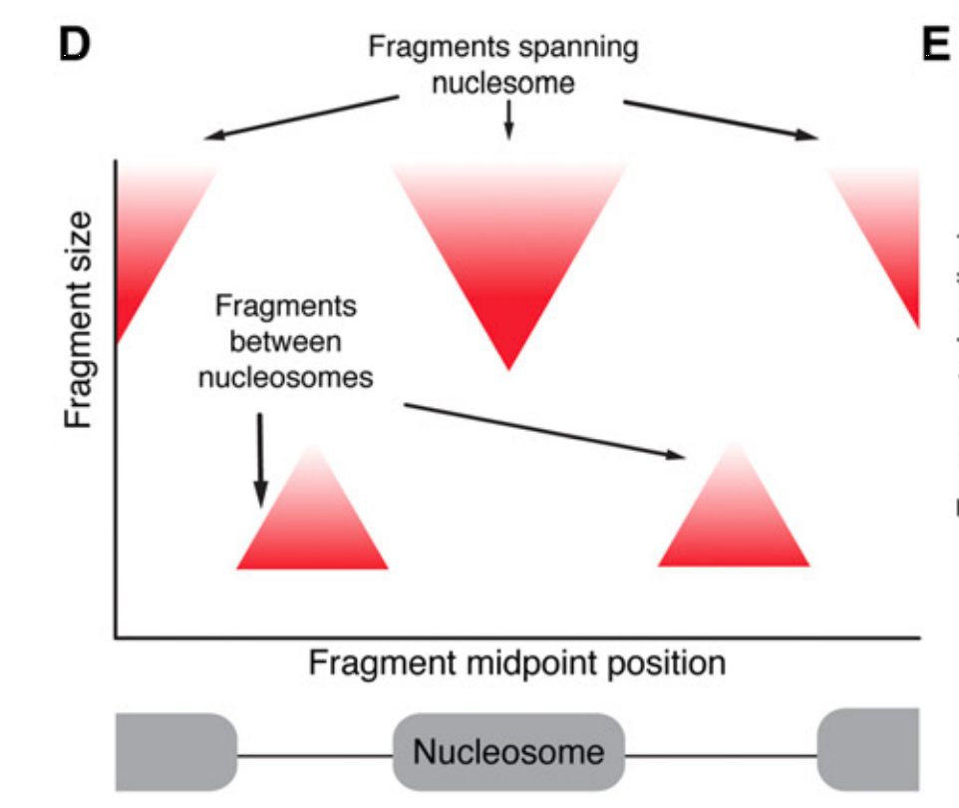
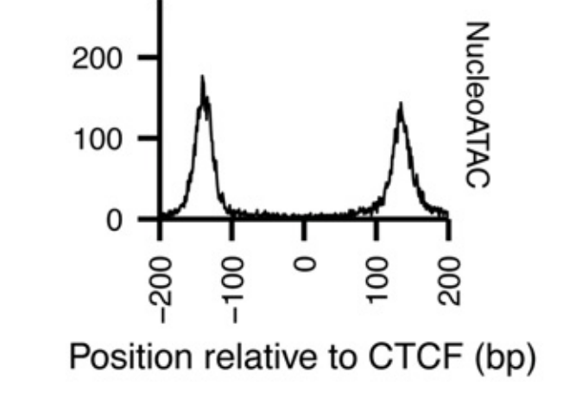
2. Nucleosome calling with ATAC-seq
Schep et al. Genome Research (2015)

Slide 31
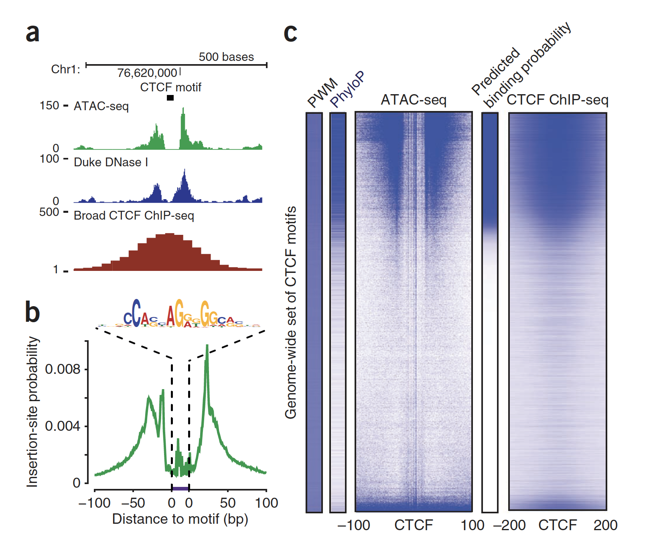
3. Tn5 cutsites enable factor footprinting
Buenrostro et al. Nature Methods (2013)

Slide 32
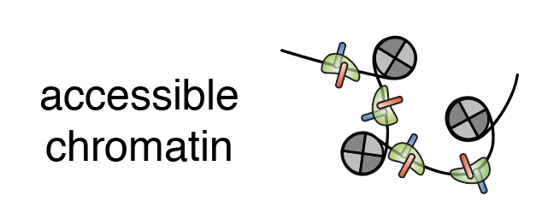
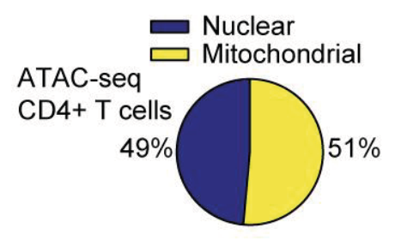
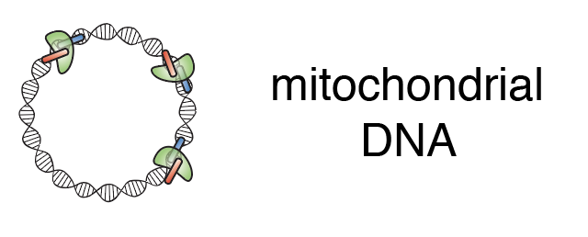
4. Mitochondrial reads in ATAC-seq
+

Slide 33
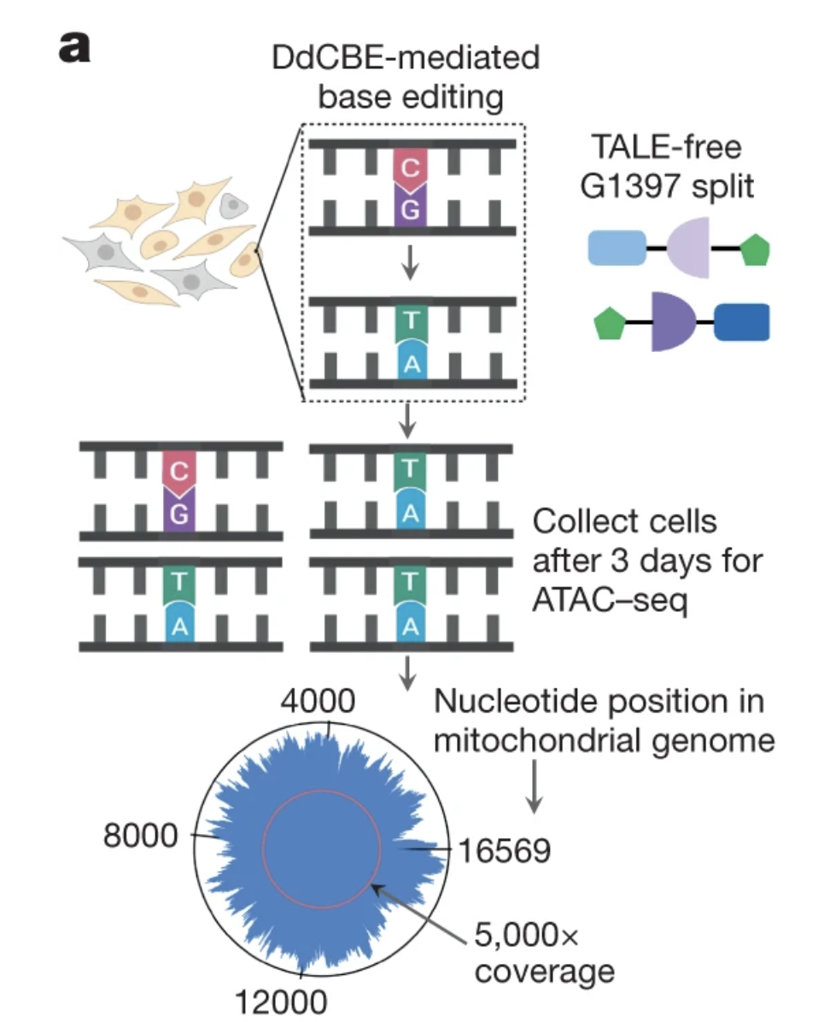
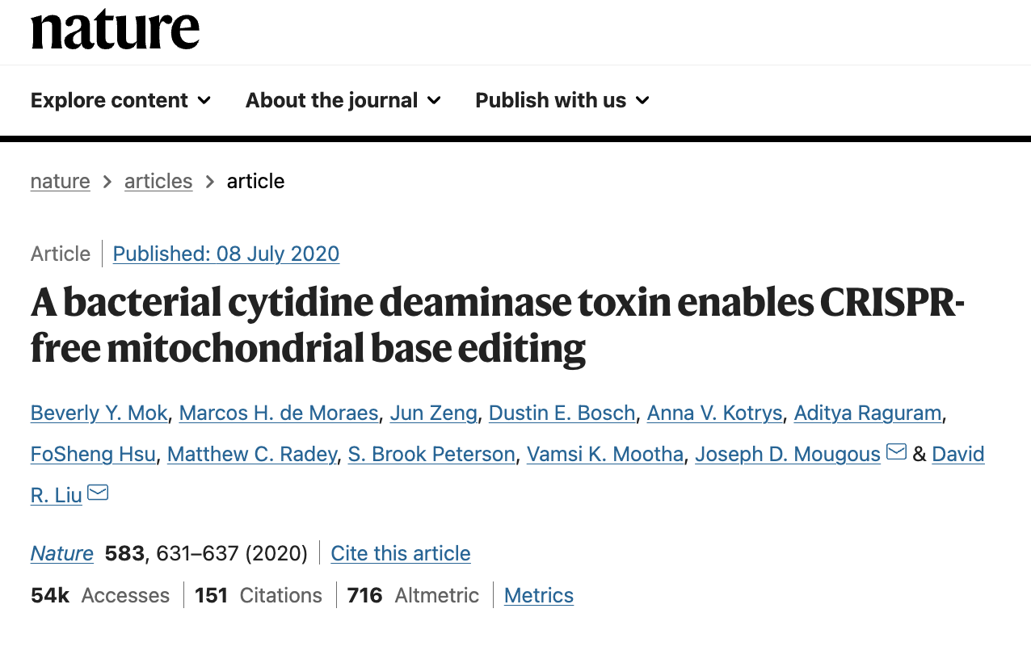
ATAC-seq in mitochondrial gene editing

Slide 34
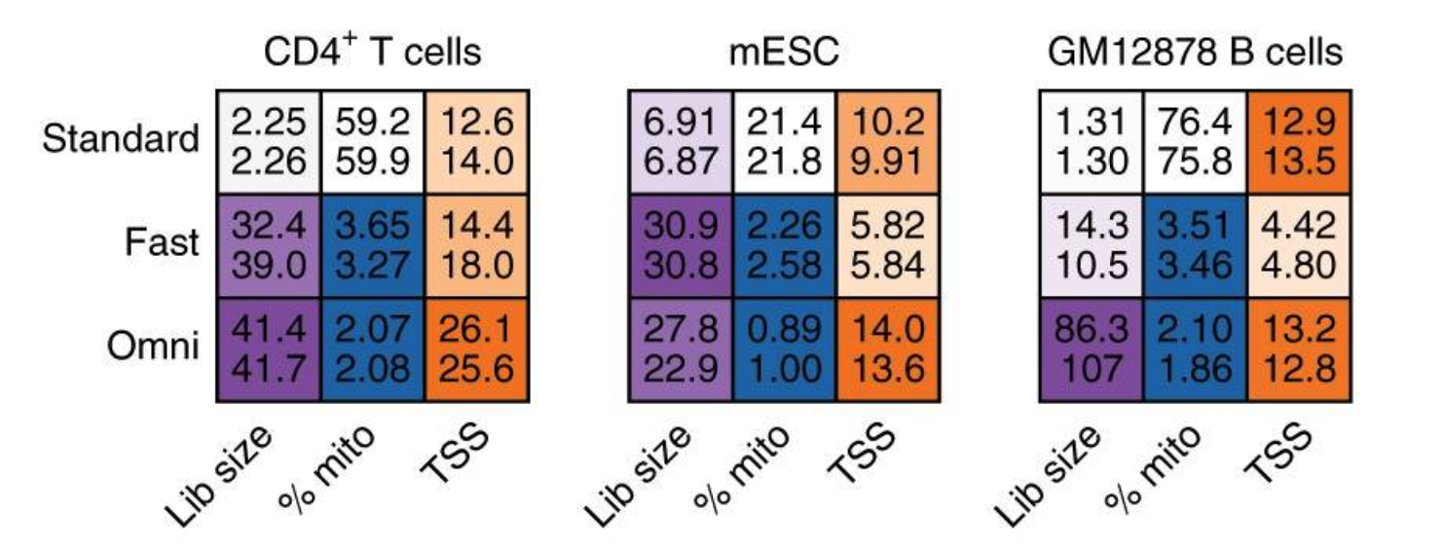
Newer versions of ATAC-seq
Fast-ATAC: Corces et al. Nat Genetics (2016)
Omni-ATAC: Corces et al. Nat Methods (2017)

Slide 35
Summary
ATAC-seq provides a rich data source to characterize nucleic acids and chromatin biology in cell types
Accessible chromatin may provide a more information-dense measure of cell state than transcriptomics
Newer versions of the ATAC-seq protocol (Fast and Omni) enhance data quality (but not if you care about the mitochondrial genome)

Slide 36
Part III: Single-cell ATAC technologies

Slide 37
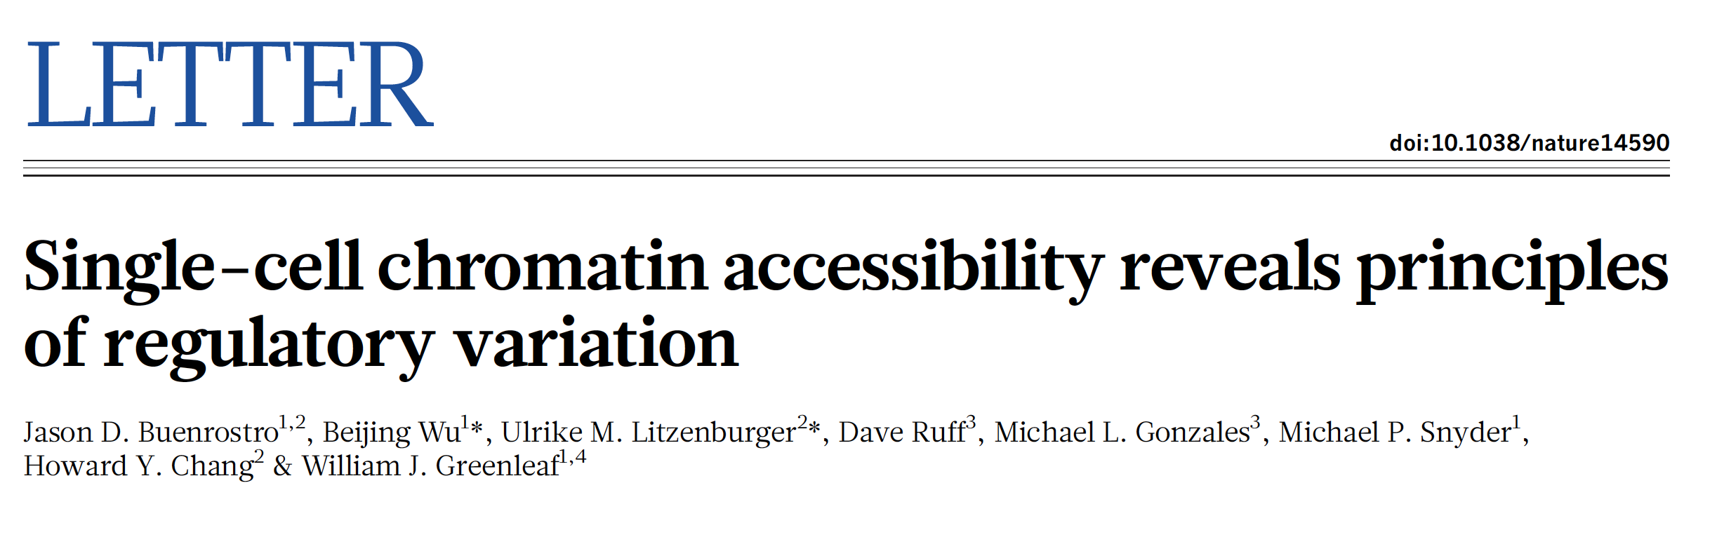
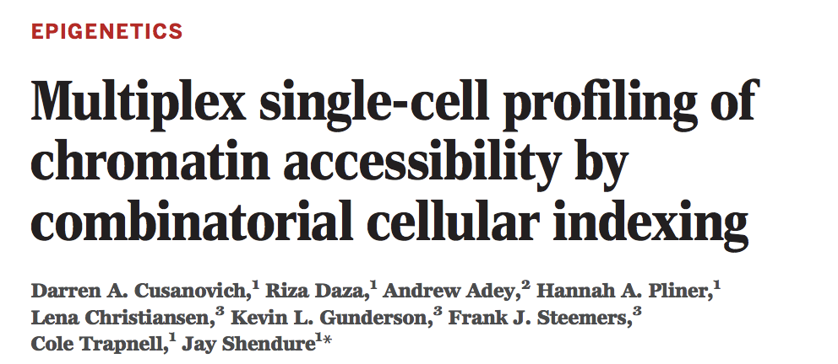
‘Phase 1’ Technologies for scATAC
Buenrostro et al. Nature (2015)
Cusanovich et al. Science (2015)

Slide 38
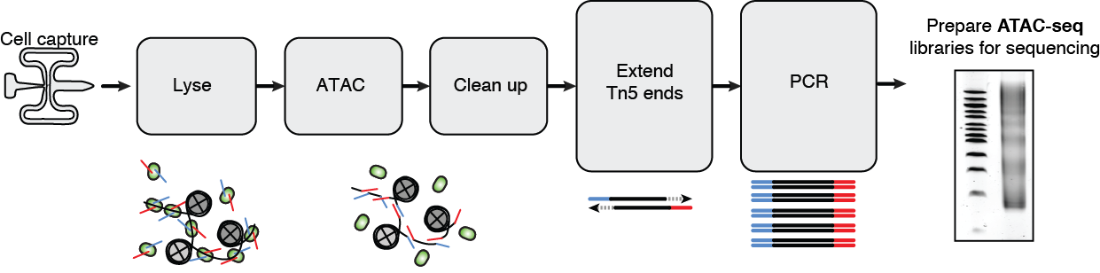
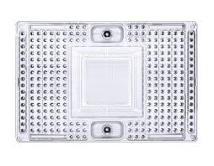

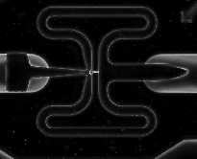
Fludigm C1 (Buenrostro et al. Nature 2015)
Buenrostro et al. Nature (2015)

Slide 39
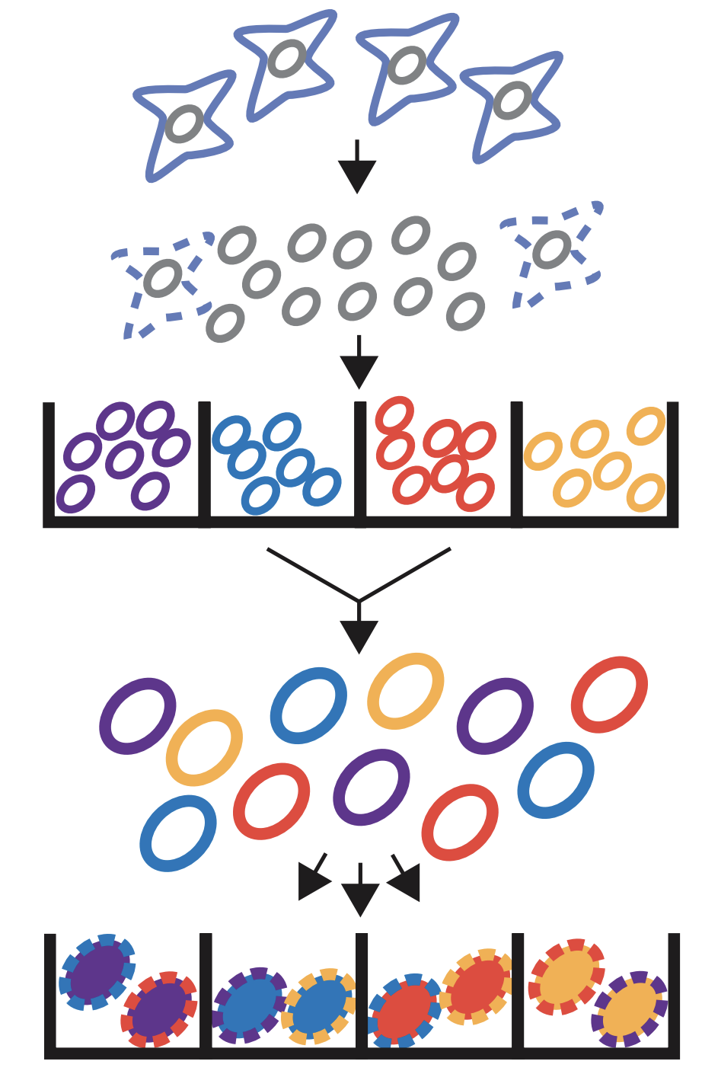
Split-pool (Cusanovich et al. Science 2015)
Cusanovich et al. Science (2015)

Slide 40
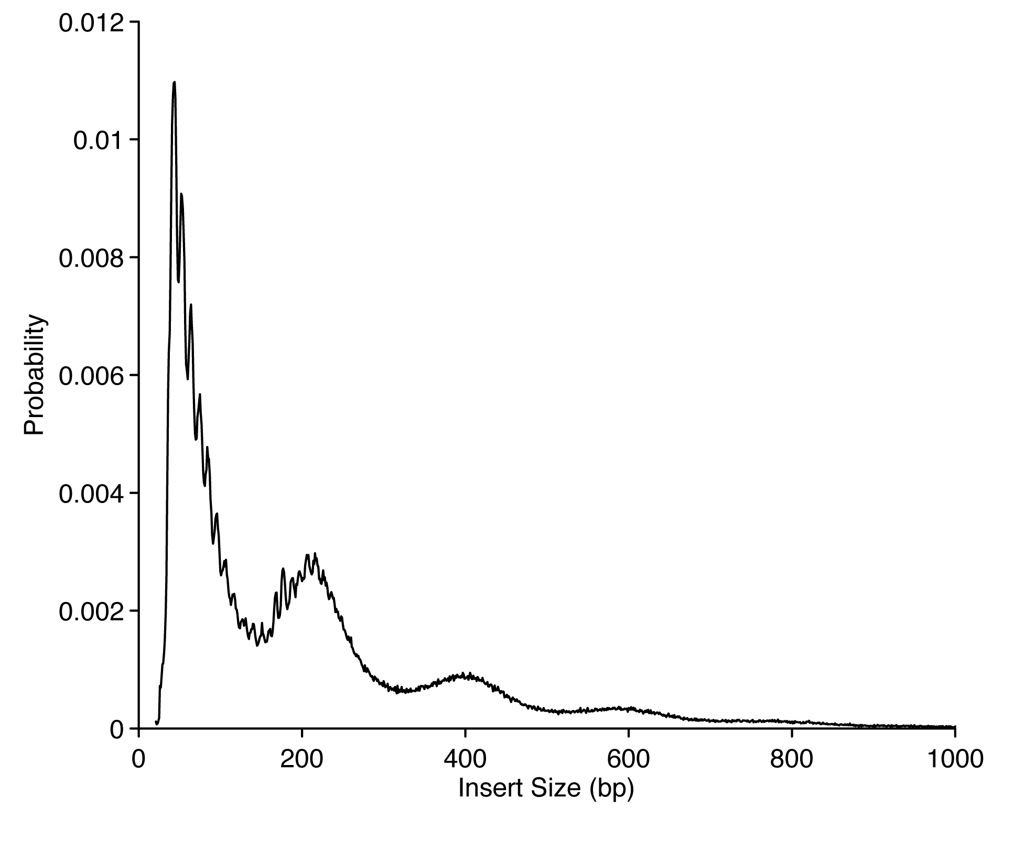
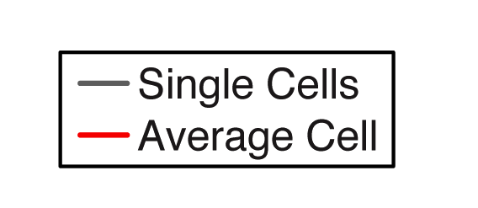
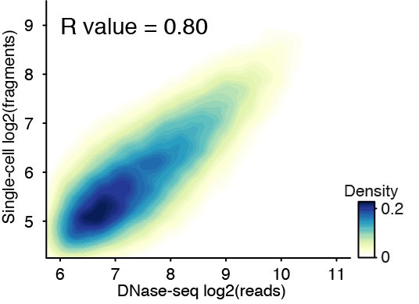
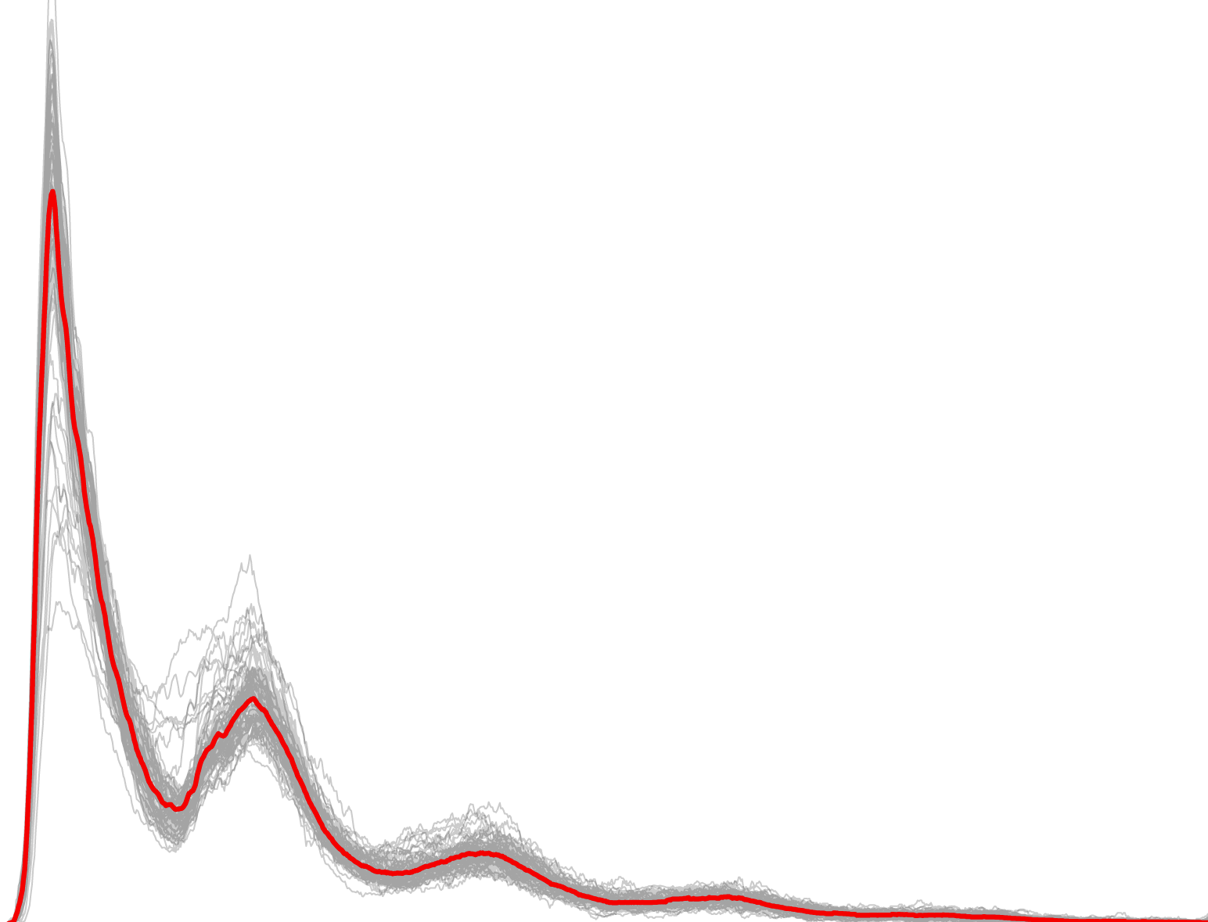
scATAC-seq accurately measures chromatin accessibility
50,000,000 cells
50,000 cells
254 single-cells
Mean: 0.08 fragments per peak
Buenrostro et al. Nature (2015)

Slide 41
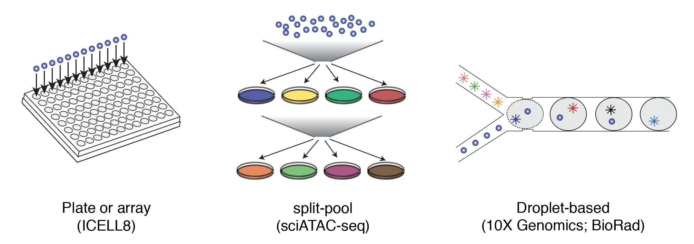
‘Phase 2’: Improved technology → Improved data
Satpathy et al. Nat. Biotech (2019)
Lareau et al. Nat Biotech (2019)
Mezger et al. Nat. Comm (2018)
Lake et al. Nat. Biotech (2019)
Cusanovich et al. Cell (2018)

Slide 42


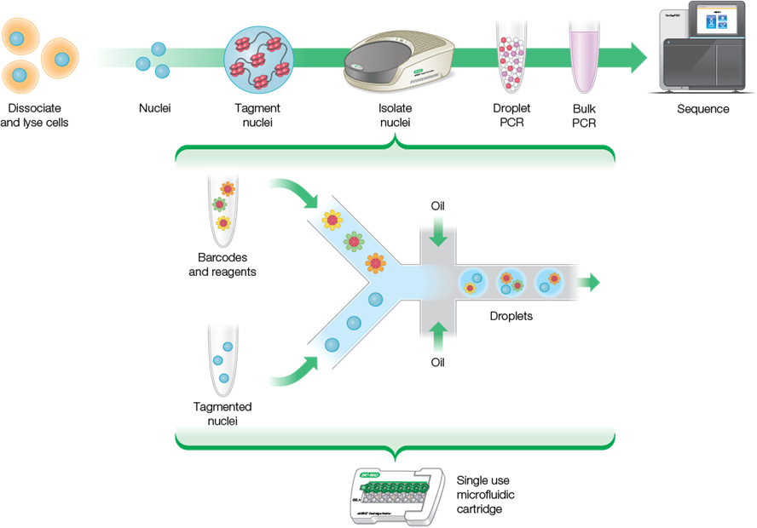
Overview
Total workflow time:
8 hours
BioRad Life Sciences

Slide 43


Improved data quality
Droplet based protocols (10x + BioRad)
provide the highest per-cell data abundance
compared to other technologies
Also enable thousands of cells per experiment
Lareau et al. Nature Biotechnology (2019)

Slide 44


These products are commercially available
See: Satpathy et al. Nature Biotechnology (2019)
See: Lareau et al. Nature Biotechnology (2019)
→ The development of these technologies now position scATAC-seq ~ scRNA-seq

Slide 45
Summary
Phase 1 technologies (2015) largely revealed epigenomic heterogeneity in cell lines with limited cell throughput
Phase 2 technologies (2018-2019):
Improve data quality by 1-2 orders of magnitude
Increase cell capture by 1-2 orders of magnitude
Are extremely cost-effective
Commercially available
Can be broadly applied to primary tissues

Slide 46
Part IV: Thinking about scATAC-seq data

Slide 47


How do we think about scATAC analyses
Nucleosomes, footprints, etc.
Currently unexplored in scATAC
Lareau et al. Methods in Molecular Biology (2019)

Slide 48

Annotating cell states with TF activities
Lareau et al. Nature Biotechnology (2019)

Slide 49

Chromatin accessibility profiles of cell types reconstituted from scATAC
Lareau et al. Nature Biotechnology (2019)

Slide 50


Other emerging scATAC applications

Slide 51


Individual CD34+ cells are marked via a unique “zip code” of somatic mtDNA mutations
Ludwig*, Lareau*, et al. Cell 2019

Slide 52

High throughput in vivo human cell lineage tracing
+
Lareau et al Nature Biotechnology 2021

Slide 53

Clonal tracing in native hematopoiesis in humans in vivo
Lareau et al Nature Biotechnology 2021

Slide 54


Some questions going on in the Satpathy lab
Clonal evolution in Nature Killer cells in response to CMV in vivo
Similar questions about myeloid cell evolution in tumors and tissues

Slide 55
The applications of scATAC + other modalities keeps growing!
scATAC-seq plus:
Surface Proteins (ASAP-seq)
Nanobody detection (Phage-ATAC)
Intracellular antibodies (NEAT-seq)
RNA (10x Multiome; SHARE-seq)
RNA + Protein (DOGMA-seq; TEA-seq)
mtDNA (mtscATAC-seq)
+ others!

Slide 56
Summary of last section
Single-cell ATAC-seq is now how most ‘good’ regulatory element mapping is done
Each cell lives in a high-dimensional state; cell types and trajectories are analyzed with tools like PCA → UMAP/tSNE; similar to scRNA/CyTOF/etc.
Once cell states can be inferred, one often does ‘pseudobulk’ analysis mirror the more established regular ATAC-seq workflows.
Multi-omic measurements are widely available to build upon ATAC-seq regulatory element mapping

Slide 57
Thank you!
Practicum: deep dive into Corces et al 2016 Nature Genetics
Go to bit.ly/atac206
clareau@stanford.edu

